Slide 1
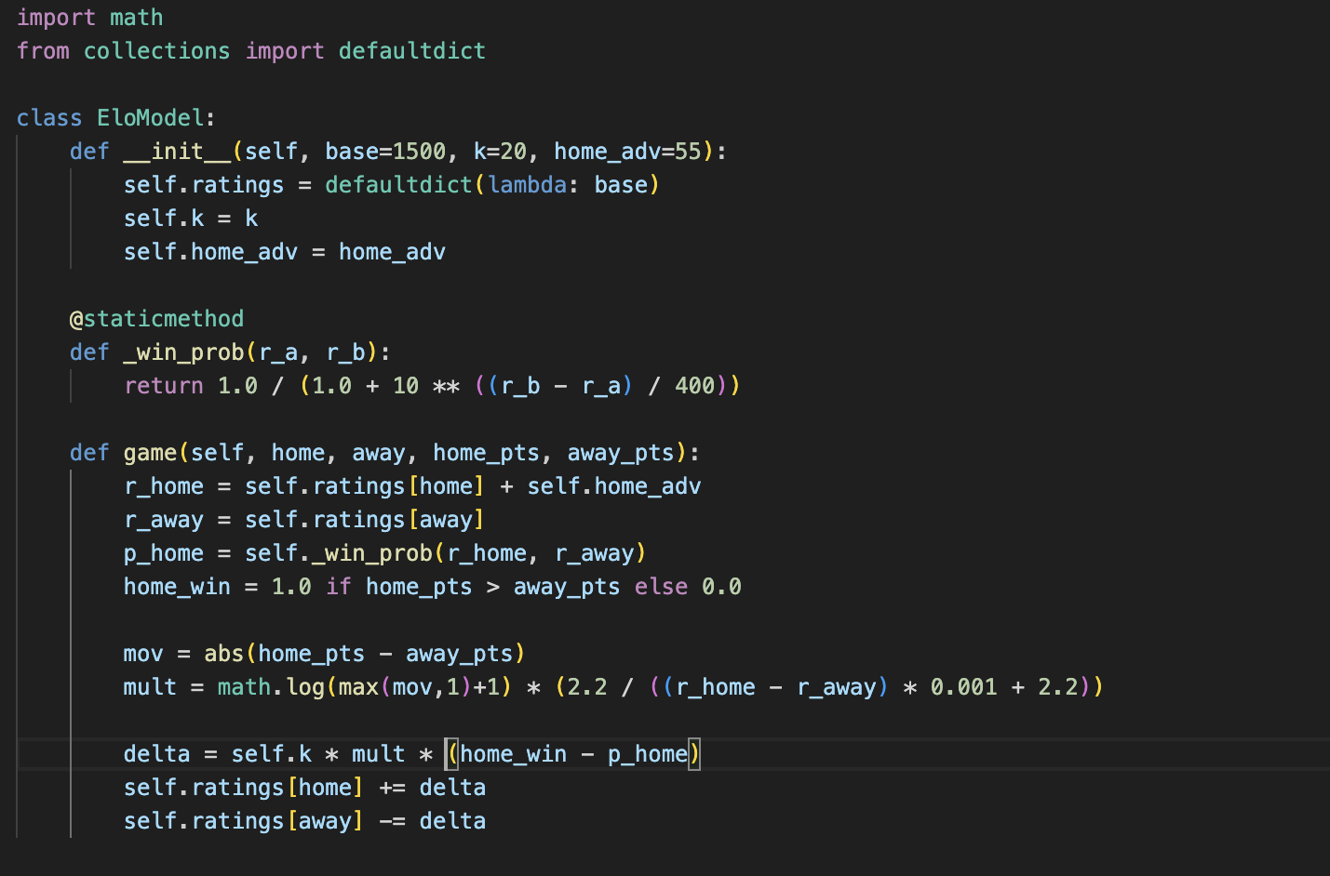
NFL Super Bowl Probability Simulator
Simulates the NFL playoffs using Elo ratings to predict outcomes
Jalen hannah

